Slide 1


Slide 2
LET’S BEGIN
1) Install Git
2) Create a GitHub Account
3) Create a HacktoberFest Account
4) Sync the GitHub and HacktoberFest Profile

Slide 3
Git and GitHub

Slide 4
What is Git?
Version Control System (VCS) for tracking changes in computer files.
Distributed version control system
Coordinates work between
Who made what changes and when
Revert back at any time
Local & remote repos

Slide 5
Concepts of Git
Keeps track of code history
Takes “snapshots” of your files
You decide when to take a snapshot by making a “commit”
You can visit any snapshot at any time
You can stage files before committing

Slide 6


Slide 7
Online git repo hosting service
Collaborate
Online secure backups
Open source community

Slide 8
repos/remotes
git init - creates a new git repo for that folder
git clone <url> - creates a copy of a remote repo in a new directory
git remote - lists all remote git repos

Slide 9
Staging

Slide 10
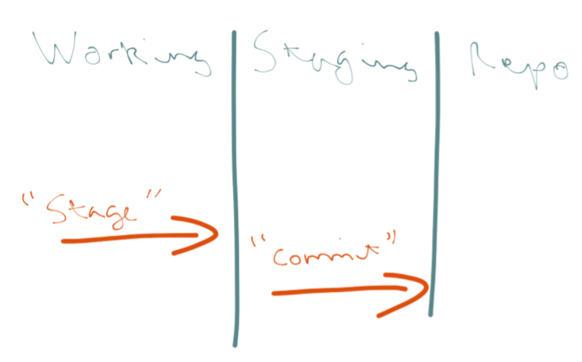

Slide 11
file changes and commit
git status - shows differences between index and current HEAD commit
git diff - shows changes between commits
git log - detailed version of commit history
git add <name> - stage new file for new commit
git commit -m <message> - add snapshot of code

Slide 12
Branches and merging

Slide 13
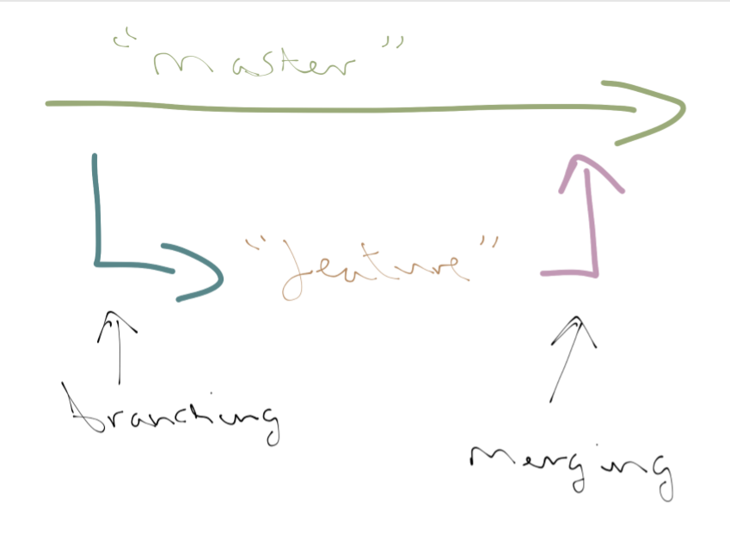

Slide 14
branches
git branch - lists all local branches
git branch -a - lists all local and remote branches
git branch -d <branch-name> - deletes a branch
git branch -m <old-name> <new-name> - renames a branch
git checkout <branch-name> - switch to a different branch
git checkout -b <new-branch-name> - create a new branch and switch to it

Slide 15
merging
git push <remote> <branch> - adds objects to merge the diffs in remote git repo
git pull <remote> <branch> - gets objects from the remote repo and merge the diffs
git fetch [<remote>] - gets objects from remote repo, but doesn’t a merge in the diffs

Slide 16
Git Tips
Use feature branches
Commit often
Stick with one commit message style
Use Git for everything
Push to remote repo often

Slide 17
https://github.com/AdityaSrivast/hacktoberfest-local-meetup

Slide 18
First issues
https://up-for-grabs.net
https://www.codetriage.com/
https://24pullrequests.com/
https://firstcontributions.github.io/

